Slide 1
Addition Polymer Part II
Jimmy Ip 13
Andy kwok 14
Kim leong 18
Dicky ng 23
Vincent si 25

Slide 2
Content
Polyethene
High and low density
Polypropene
Polyvinyl choride
Polystyrene
Expanded polystyrene
Perspex

Slide 3

Polyethene
Addition polymer of ethene
Low-density polyethene (LDPE)
High-density polyethene (HDPE)
Very cheap

Slide 4
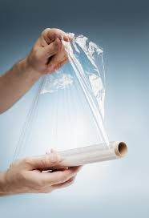
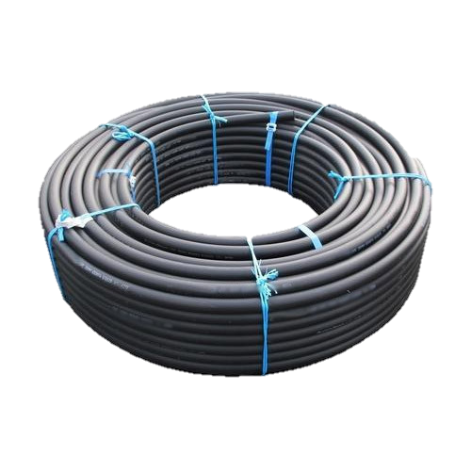
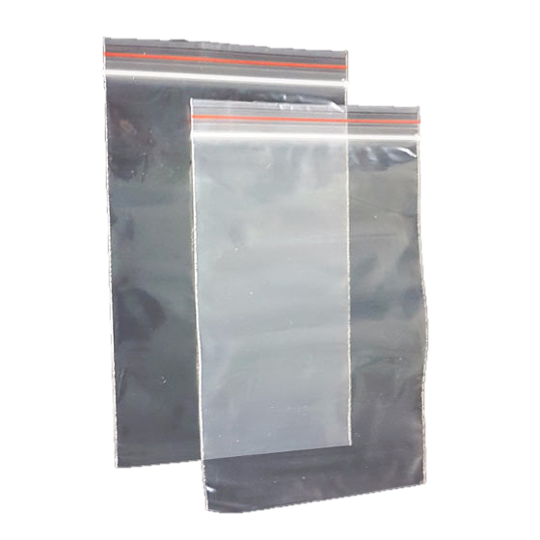
Low-density polyethene
Melting point: 105℃
Softens in boiling water
Flexible

Slide 5
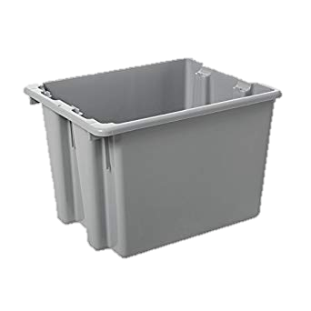
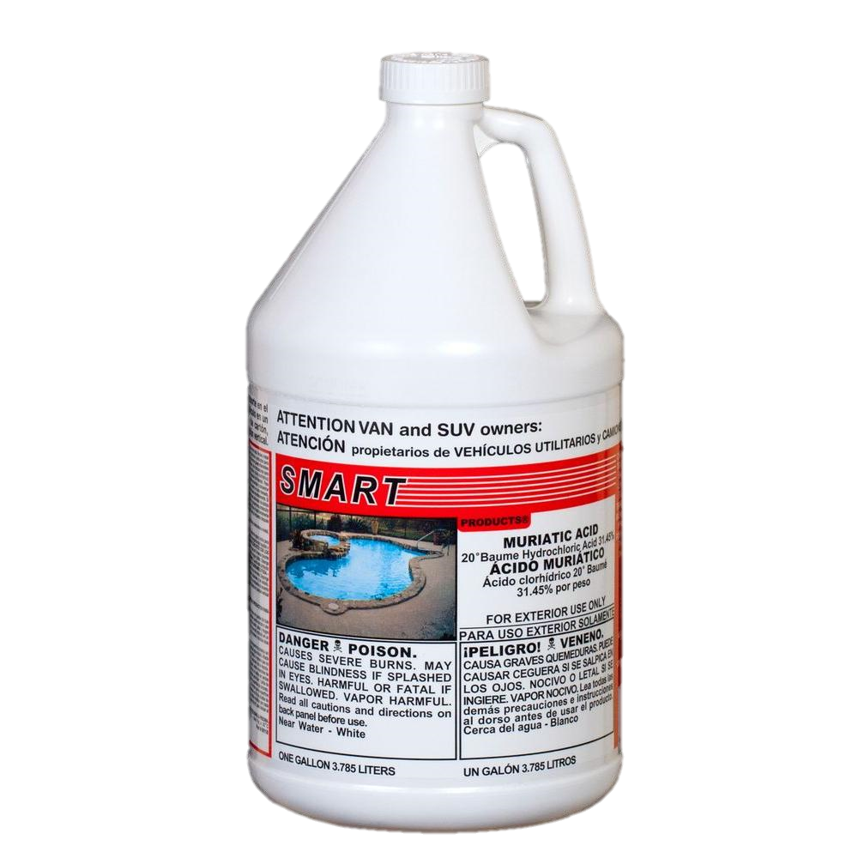
High-density polyethene
Melting point: 135℃
Rigid

Slide 6

Polypropene

Slide 7
Polypropene
Melting point: 165℃
↓ between low and high density
Resists to…
Chemical solvents , acid, alkalis

Slide 8
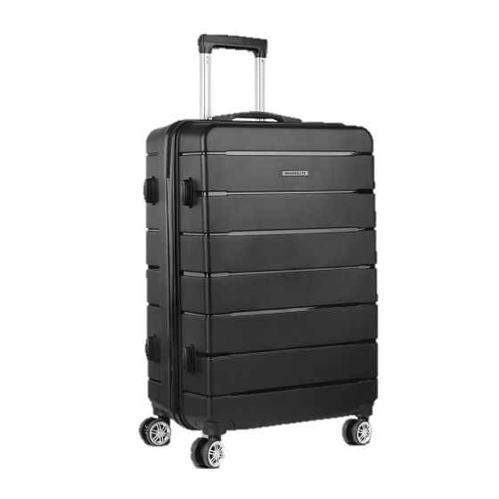
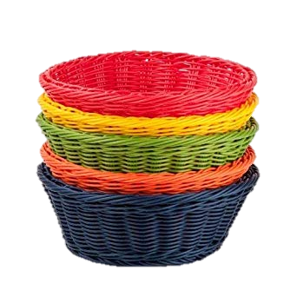
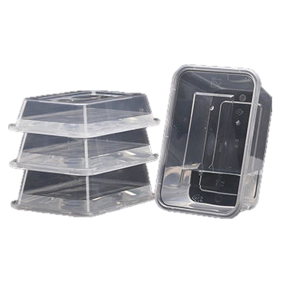
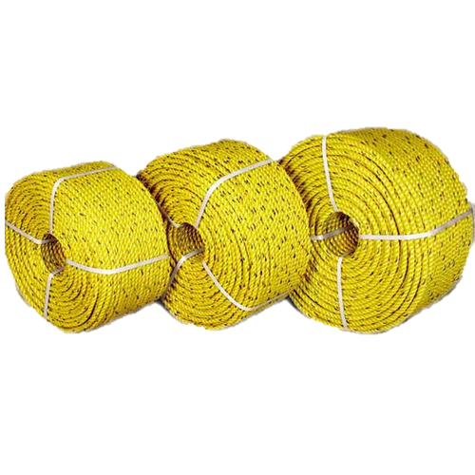
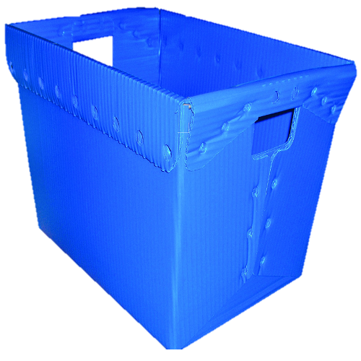
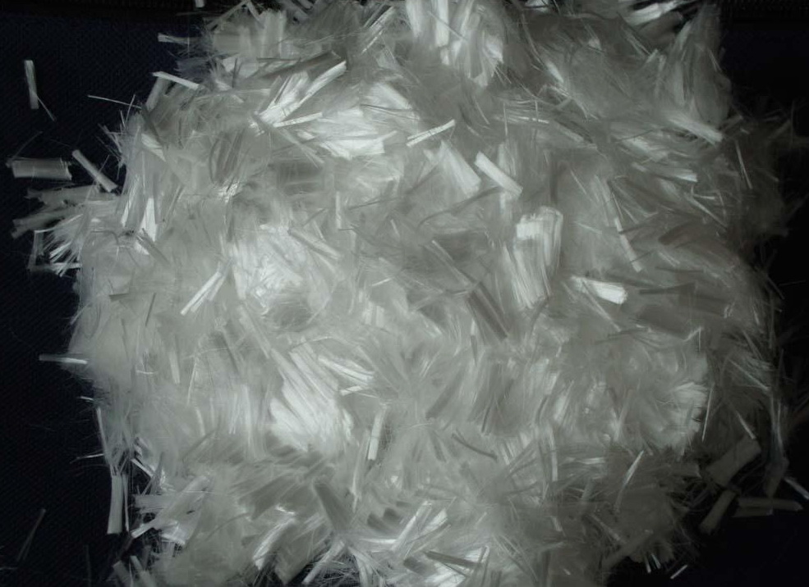
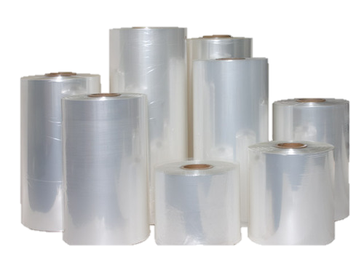
Example
Ropes
Fibres
Basket
Boxes
Luggage cases
Food containers
Packaging Film

Slide 9
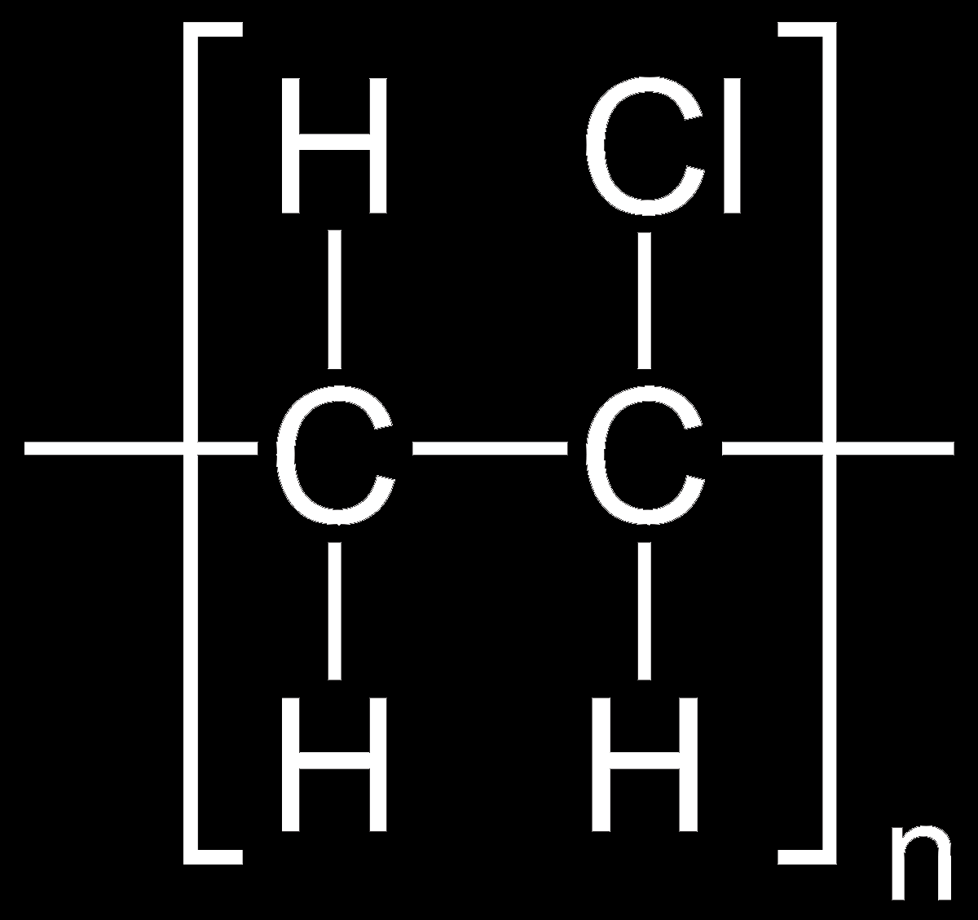
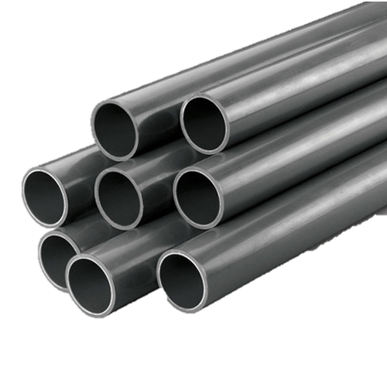
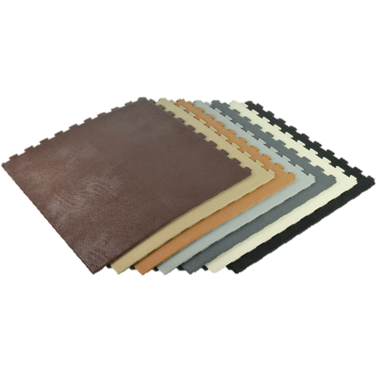
Polyvinyl Chloride (PVC)
Stiff and brittle
Mixed with PLASTICIZER
Become more flexible
Properties varies with the amount
X plasticizer→ quite rigid
Floor tiles
Pipes

Slide 10
Polyvinyl Chloride (PVC)
With suitably plasticized……
Soft and flexible
Water resistant
Good insulator of electricity
X food container→ poisonous

Slide 11
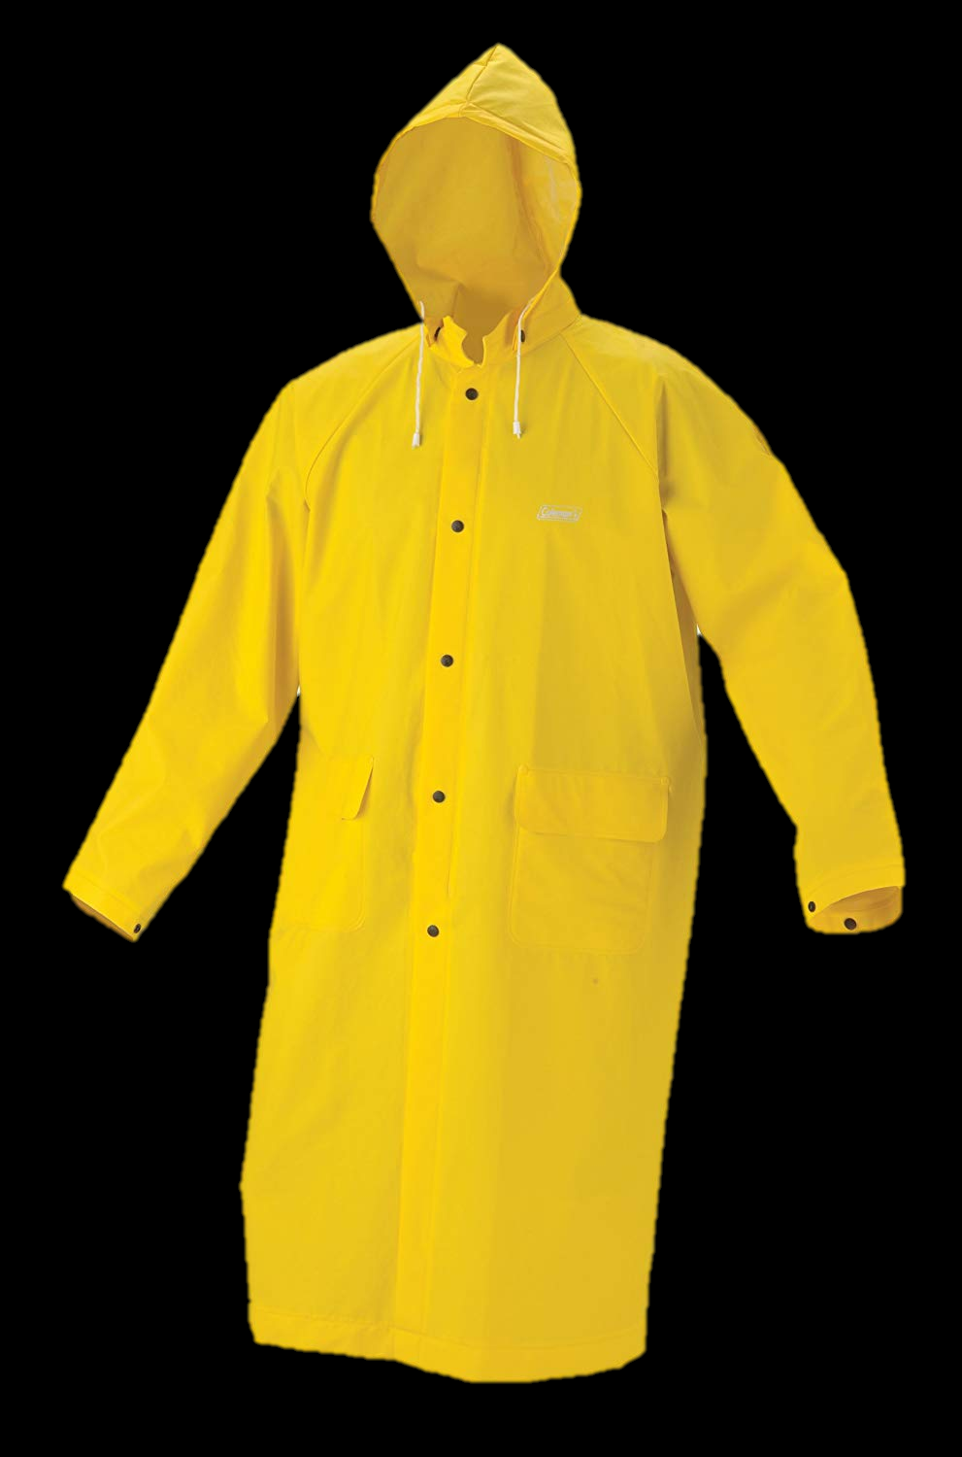
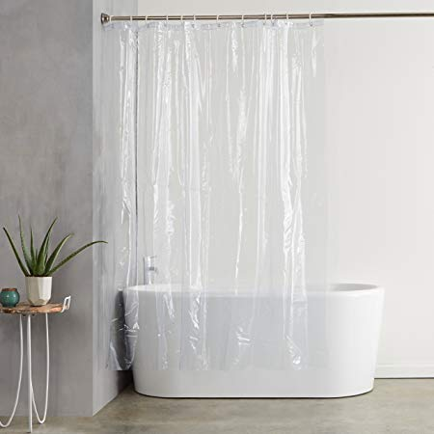
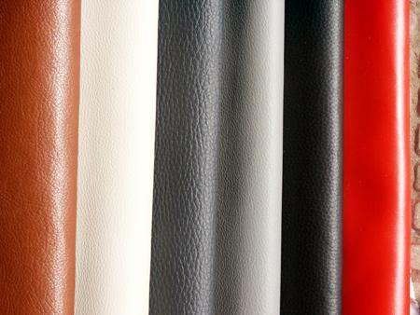
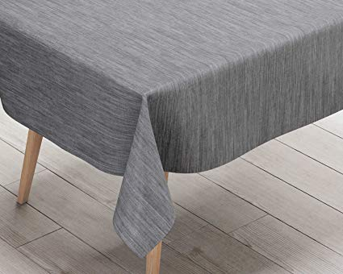
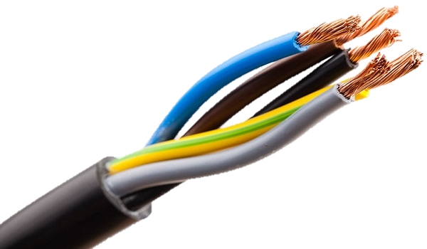
Example……
Shower curtains
Tablecloths
Raincoats
Artificial leather
Insulating coverings for wires

Slide 12
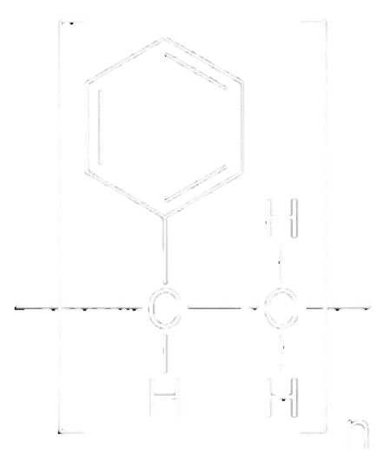
Polystyrene(PS)
Transparent, hard
Brittle

Slide 13
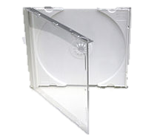
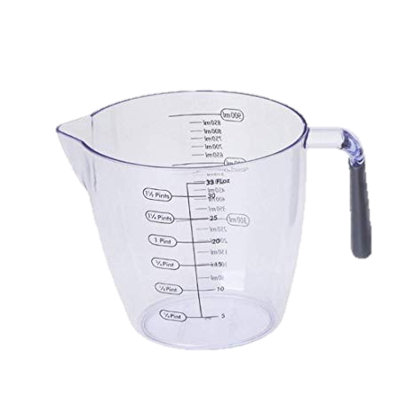
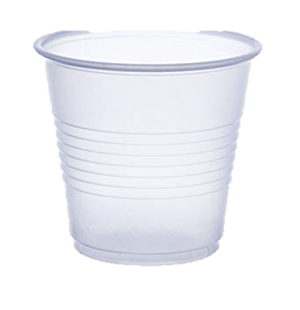
Polystyrene(PS)
Example:
cups, compact disc cases, measuring cups

Slide 14
Expanded Polystyrene
Heating granular polystyrene(with a foaming agent) → Expanded Polystyrene
White solid foam
Very low density
Pretty rigid
Excellent heat insulator and shock-absorbent
Non-toxic

Slide 15
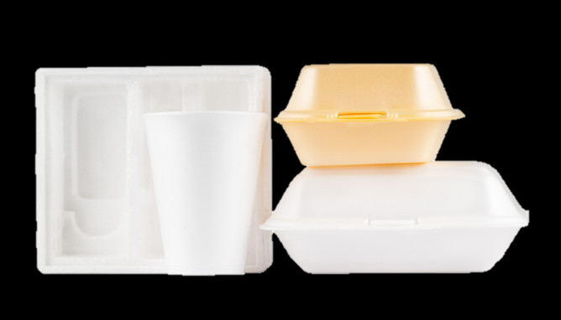
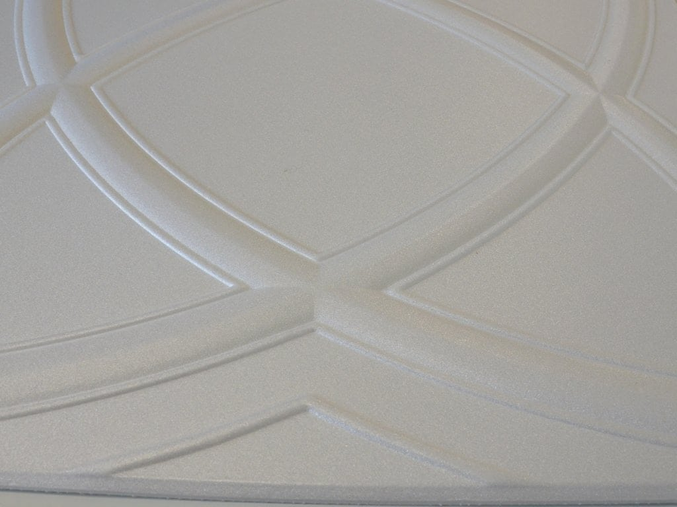
Expanded Polystyrene
Example:
disposable cups and food boxes
lightweight ceiling tiles

Slide 16
Perspex
Or called polymethyl methacrylate/ acrylic
Hard, tough, rigid
Highly transparent
But easily scratched
Substitute for glass

Slide 17
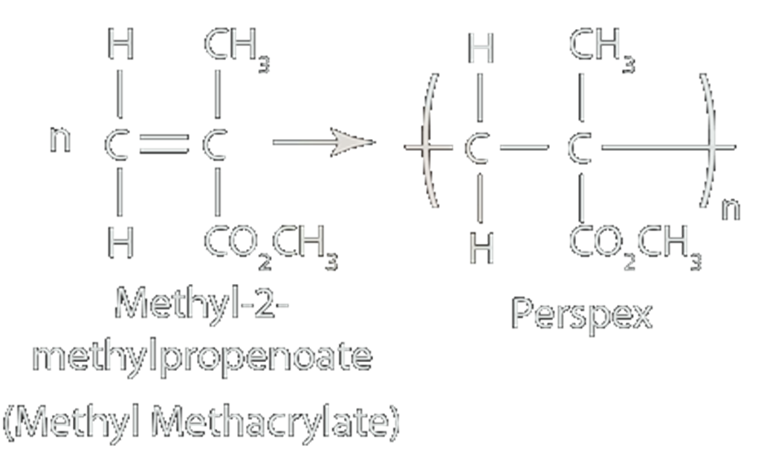

Slide 18
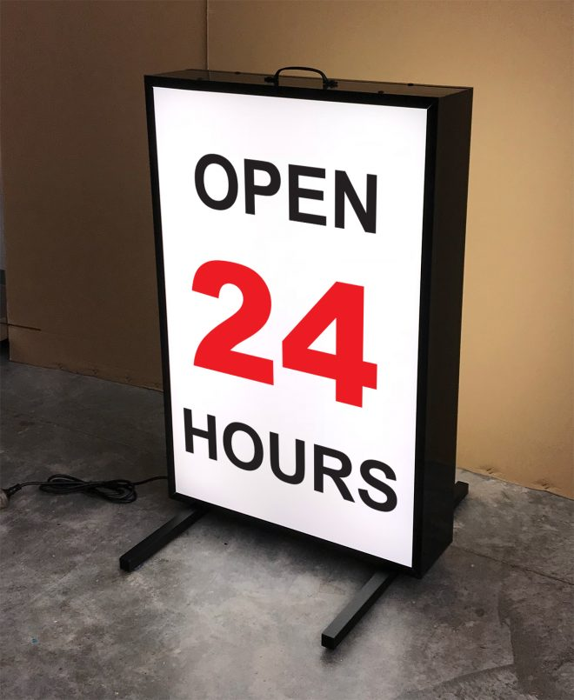
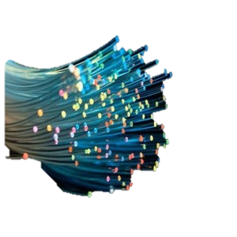
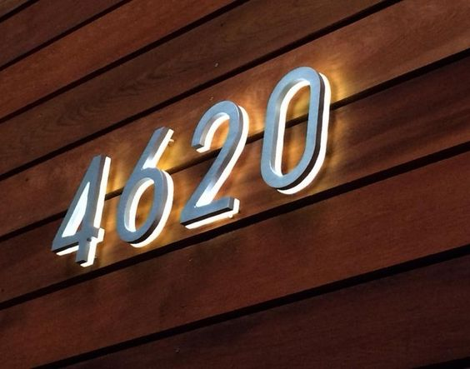

Perspex
Example:
Aeroplane windows
Advertising sign boxes
Plastic optical fibres
Illuminated signs

Slide 19


